Slide 1
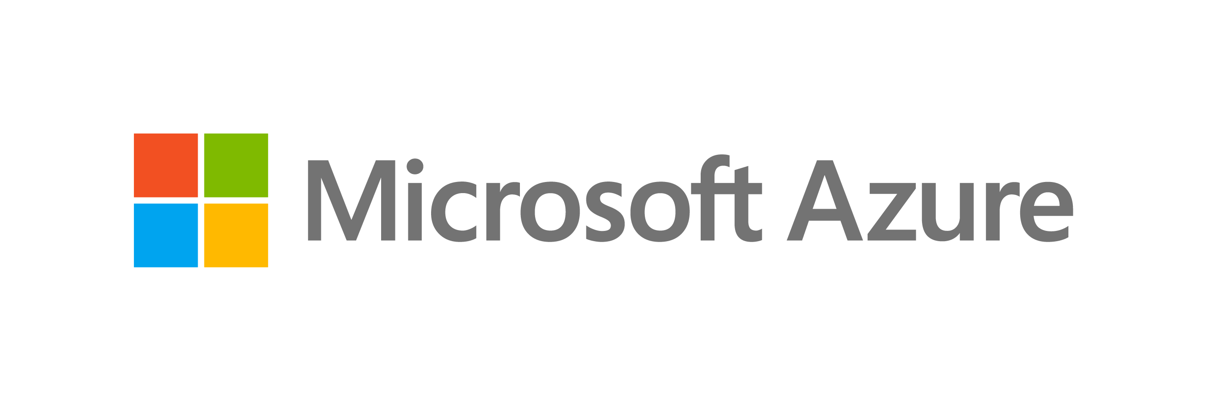

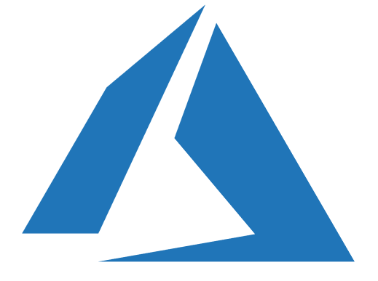
Azure Transformation Days
Notes:
Migrate to Azure with confidence: Start Moving Your Applications, Data, and Infrastructure Today

Slide 2
Section Title
Presenter Name

Slide 3
Top 3 learnings
1
It’s a great opportunity to ‘clean house’ - retire applications that are no longer used or consolidate and transition functionality to off-the-shelf solutions where possible.
No cloud hosting model (IaaS, PaaS, SaaS) should be taken off the table too early.
Move custom applications in stages:
Move simple workloads directly to PaaS: web sites, static portals, standard three-tier applications.
Migrate complex solutions to IaaS first to unlock immediate benefits and gradually modernize later.
Keep legacy/undocumented code as-is and surround it with serverless functions to add features.
Download the eBook
https://azure.microsoft.com/resources/inside-microsoft-cloud-migration-journey/
2
3

